Slide 1
Monthly Meeting
November 28, 2012

Slide 2
Agenda
Introductions
Review/Approval of October meeting notes
Platform & Technologies
Datasets & Data Stewards
Quality of Life Indicators
Reflection for Decision-making
Topics/format for future agendas
Announcements

Slide 3
Platform & Technologies
Urban Institute Contract
Tutorial with Urban Institute for Loading Datasets into Platform
Updated Community Indicators document for Annotations
Weebly website
Yahoo Group/List for email distribution
Notes:
Tutorial with Urban Institute for Loading Datasets into Platform
January 16th in the AM (next meeting)?
Weebly website
:For everyone’s convenience, meetings are now posted in a calendar
Changes/updates can be made by any collaborator
Yahoo Group/List for email distribution (provides archive and makes sure everyone is in the loop)?

Slide 4
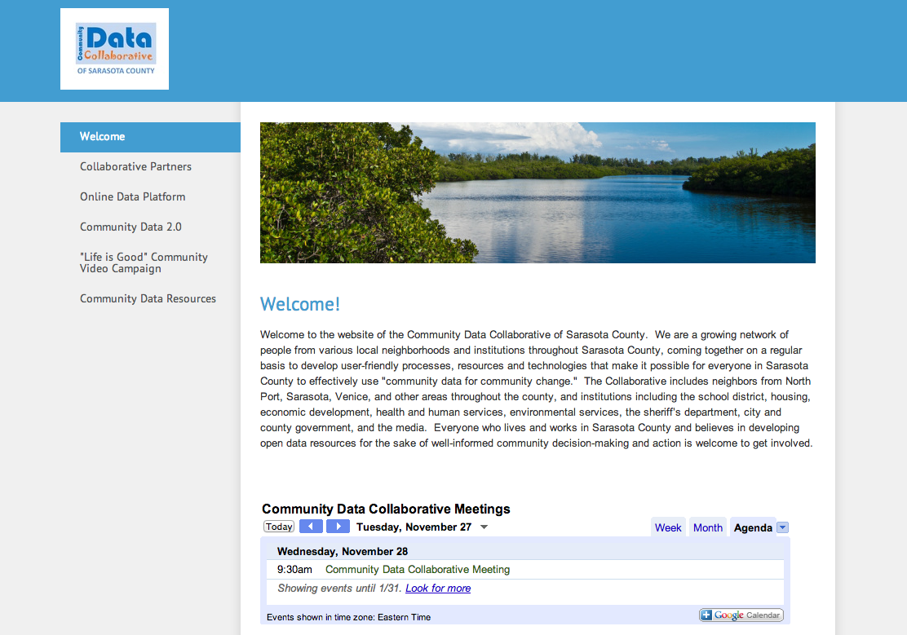
www.sccommunitydatacollaborative.weebly.com

Slide 5
Datasets & Data Stewards
Demographics of Census Geographies in relation to Neighborhood demographics
UnidosNow
Other datasets/stewards?

Slide 6
Total Population: Census Block Groups

Slide 7
Total Population: Neighborhoods

Slide 8
Quality of Life Indicators
Report back from CIC Conference
Data 2.1 Workshops for 2013
Last year: municipalities and demographic hotspots
Notes:
2.1 sessions will be similar format while also exploring new opportunities.

Slide 9
Reflection for Decision-Making
-Form: What it means to be a partner in the Data Collaborative
-Report back from regional GIS Day

Slide 10
Topics/format for future agendas
-Focus on Platform on 1/16
-New Collaborative Logo Opportunity
-Other?

Slide 11
Final Announcements
Thank you, Florida House
Next meeting location: North Port?
Other announcements?

Slide 12
Developing a Community Data Collaborative
Online Gathering of Perspectives
Data Stewards Group Meetings
In-person Convenings
(Other)
Quality of Life Indicators
Datasets
&
Stewards
1:1 with Data Stewards
Data 2.0 Sessions
Reflection for
Decision-Making
Platform
&
Technologies
Online Community Platform
Residents
Institutions / Sectors
Synching with other local resources / technologies
Notes:
In the interest of maintaining continuity, we’ve built the agenda around this framework so that we have to ability to touch all quadrants in our conversations.

