Slide 1
Monthly Meeting
October 17, 2012

Slide 2
Agenda
Introductions
Review/Approval of September meeting notes
Platform & Technologies
Datasets & Data Stewards
Quality of Life Indicators
Reflection for Decision-making
Topics/format for future agendas
Announcements

Slide 3
Developing a Community Data Collaborative
Online Gathering of Perspectives
Data Stewards Group Meetings
In-person Convenings
(Other)
Quality of Life Indicators
Datasets
&
Stewards
1:1 with Data Stewards
Data 2.0 Sessions
Reflection for
Decision-Making
Platform
&
Technologies
Online Community Platform
Residents
Institutions / Sectors
Synching with other local resources / technologies
Notes:
In the interest of maintaining continuity, we’ve built the agenda around this framework so that we have to ability to touch all quadrants in our conversations.

Slide 4
Platform & Technologies
Update on the Urban Institute Contract
Weebly website updated
Data Maintenance:
Keep eyes open for inconsistencies
Annotations/asterisks for explanations of indicators of well-being (eg FCAT scores)
Notes:
Weebly website: has been updated with a lot of information about the data collaborative, Data 2.0 Workshops, etc
In the interest of openness, many of you should have received an invitation to edit the weebly website created for the data collaborative. Please check out the website

Slide 5
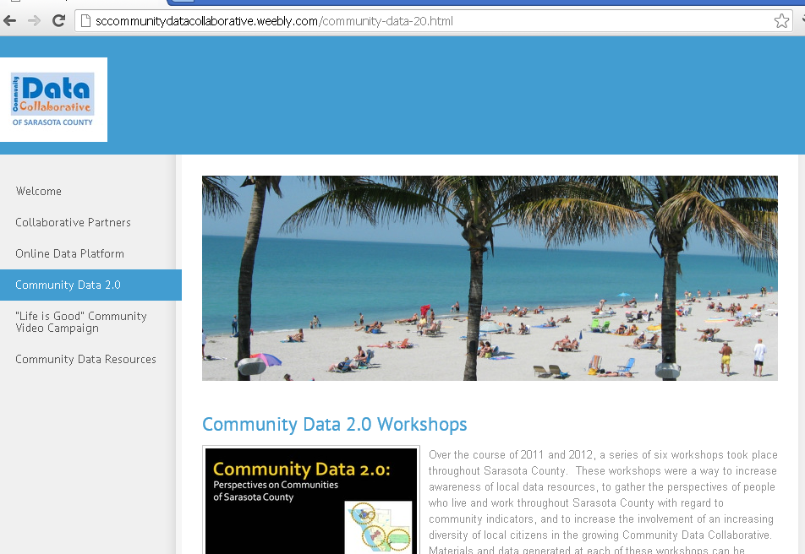
www.sccommunitydatacollaborative.weebly.com

Slide 6
Datasets & Data Stewards
School district data
Census Blocks Groups vs Neighborhoods
Sheriff’s Office IT Dept
Sarasota County Government IT & GIS
Other datasets/stewards?

Slide 7
Quality of Life Indicators
Reports on weebly website
Asterisks/annotations
Notes:
Allison & Tim presented reports to municipalities & county board of commissioners on the Quality of Life Indicators that have come up most often, which are available on the weebly website
Another item which has come up in meetings with the Sarasota County GIS folks is the question of whether or not some of the indicators of well-being need a bit more explanation for the average user of the site. Perhaps someone who is considered an “expert” on that indicator could write something which could be hyperlinked on the platform.

Slide 8
Reflection for Decision-Making
-What it means to be a partner in the Data Collaborative
-Lisa Nisenson’s article in This Week in Sarasota
-Generating examples of people using and reflecting on data resources
Notes:
-Lisa Nisenson’s article in This Week in Sarasota: opening up the data mine (which is what we are trying to do with the platform)
-Generating examples of people using and reflecting on data resources: Lou Murray & Learning Data/Bethlehem Baptist

Slide 9
Topics/format for future agendas
-Meeting on 3rd Wednesdays at 3pm?
-Twin Lakes Park or other locations?
-Printed agendas or e-agenda?
Notes:
Want this meeting to be convenient for most people.

Slide 10
Final Announcements
-GIS Day on November 14th: Does the Collaborative want to staff a table?
-Other Announcements

